Slide 1
Agile and Scrum

Slide 2
What is Agile?
Agile is a collection of principles used in software development and project management.
Agile focuses on enabling teams to deliver work in small, workable increments, thus delivering value to their customers with ease.
Evaluation of the requirements, plans, and results take place continuously.
This helps the team in responding to changes in a quick manner.

Slide 3
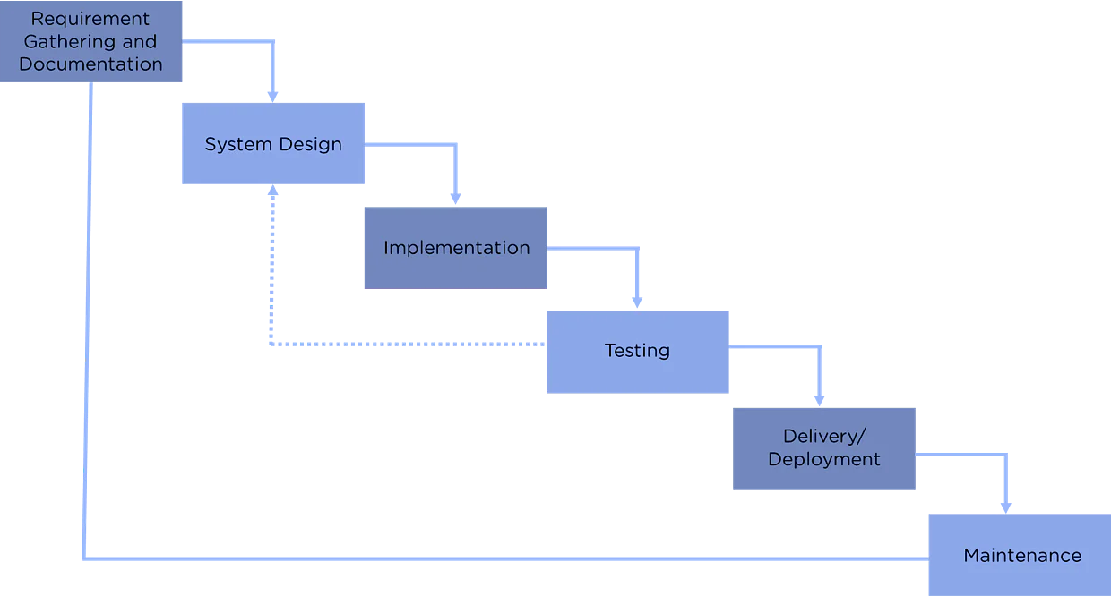
Waterfall model

Slide 4
Disadvantages
Working software isn’t created until late in the project life cycle
There’s a large amount of risk and uncertainty
Not suited for complex and object-oriented projects
It is unsuitable for long and ongoing projects
Measuring the progress within stages are difficult
Changing requirements cannot be accommodated
The end-user/client isn’t focused on
Testing is delayed until the project is completed

Slide 5
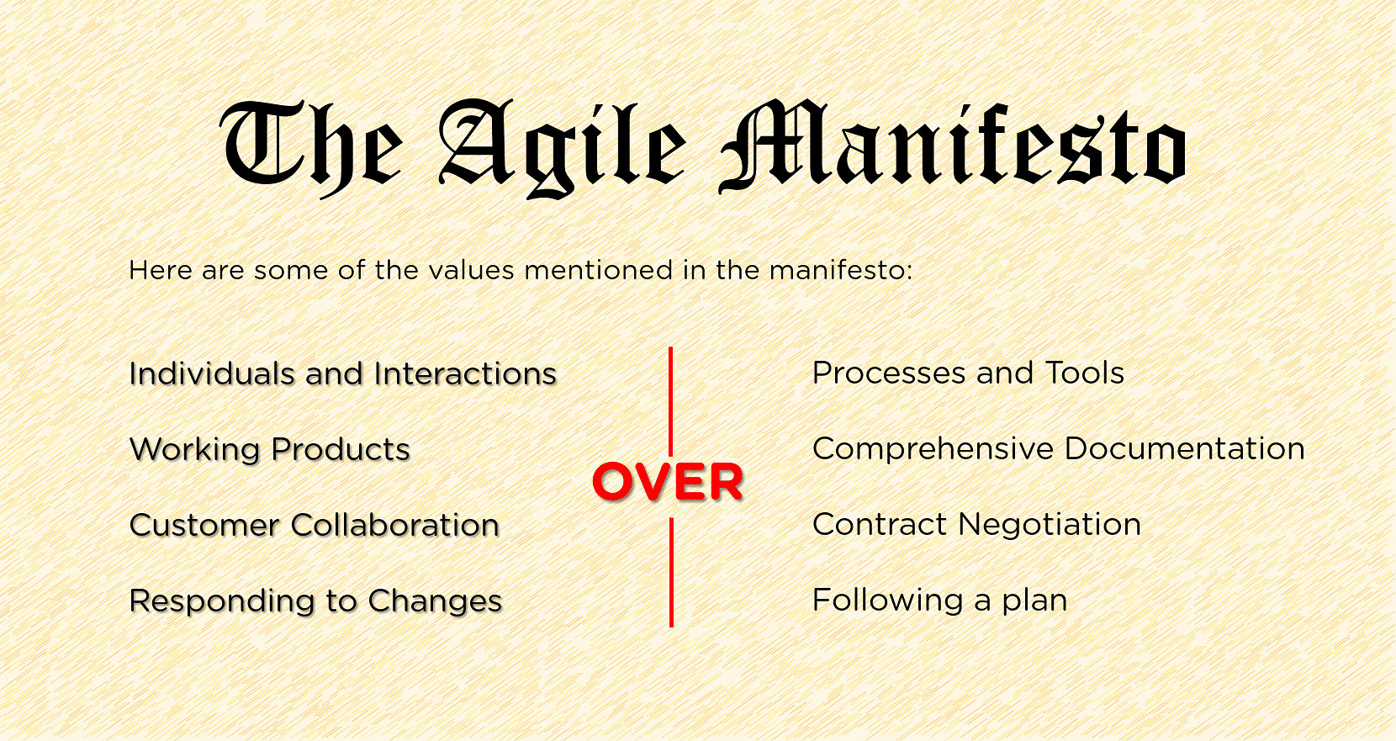
Agile manifesto

Slide 6

Agile Principles
1. Customer Satisfaction

Slide 7

Agile Principles
2. Welcome Change

Slide 8
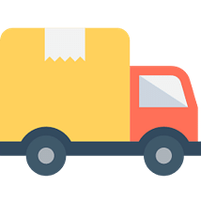
Agile Principles
3. Deliver Frequently

Slide 9

Agile Principles
4. Work Together

Slide 10

Agile Principles
5. Motivated Team

Slide 11

Agile Principles
6. Face-to-face

Slide 12

Agile Principles
7. Working Software

Slide 13

Agile Principles
8. Constant Pace

Slide 14

Agile Principles
9. Good Design

Slide 15

Agile Principles
10. Simplicity

Slide 16
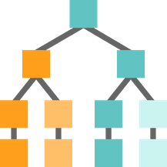
Agile Principles
11. Self-Organization

Slide 17

Agile Principles
12. Reflect and Adjust

Slide 18
Benefits
Agile enables a large amount of collaboration and interaction between the client and the project team.
clients have improved transparency, and therefore a clearer understanding of the phases of the project is present.
The product is delivered predictably, or sometimes earlier than expected.
The cost of the project is predictable and follows a rigid schedule.
Changes can refine and re-prioritize the product backlog.
Enables the client to prioritize different features, allowing the team to ensure maximum project value.
The project is broken down into smaller units, providing high-quality development, testing, and collaboration.

Slide 19
methods to implement agile:
XP
Kanban
Lean
Scrum
Crystal

Slide 20
XP (Extreme Programming)
Extreme Programming is a framework that helps teams create the highest quality of software while improving their quality of life. It combines software development with appropriate engineering processes.
When is it applicable?
When there are changing software requirements
When risks caused due to new software need to be handled
When there’s work with a small, extended development team
When technology is required for automated unit and functional tests

Slide 21
Kanban
This method is primarily used for designing, managing, and improving the flow of systems. With Kanban, organizations can better visualize their workflow and reduce the amount of work in progress.
When is it applicable?
Where the arrival of work is unpredictable
When work needs to be deployed immediately, without having to work for other items

Slide 22
LEAN
It is a set of tools and principles that identify and remove waste, to speed up process development. It emphasizes on maximizing value to the client while minimizing waste.
When is it applicable?
When used in any domain that produces any kind of waste.

Slide 23
Scrum
Scrum is a framework used by teams for establishing a hypothesis, trying out how it works, reflecting on the experience, and making appropriate adjustments. Depending on the team’s requirements, Scrum enables them to incorporate practices from other frameworks.
When is it applicable?
When teams are cross-functional and have work divided into more than one 2-4 week iteration.

Slide 24
Crystal
It is an approach to software development that emphasizes people and interactions, instead of tools and processes. It primarily focuses on streamlining processes and improving optimization.
Crystal's main principle is that all projects are unique and dynamic, with specific methods of handling each one of them.
When is it applicable?
When the primary focus is on strengthening team communication. It also focuses on continuous integration, configurable processes, and active user engagement

Slide 25
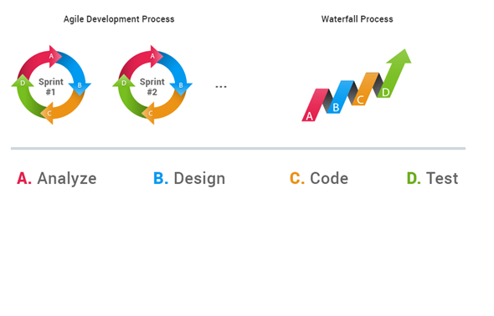
What do we mean by Agile development?
Agile is a different approach to software development which replaces the old school Waterfall software development process.

Slide 26
What is Scrum?
Scram is a framework for effective collaboration among teams working on complex products.
Scrum is a type of agile technology that consists of meetings, roles, and tools to help teams working on complex projects collaborate and better structure and manage their workload.

Slide 27
Why do we need scrum?
Teams work completely independent from each other and each sub-team completes its own activities before the other one starts its own. So what is the problem? An issue on one team, blocks the whole production line!
Everything is decided up-front! So what is the problem? Well, although the client has mentioned what she needs at the beginning of the project, but in reality what she wants may change over the course of the project, and it's not her fault! It's just how the things are... No one can completely predict the project requirements and insist on that! Things may change and new decisions must be made.
Weak estimations! As the tasks increase, the accuracy of how long each task takes decreases... Because unforeseen issues always arise, like bugs or client requirement changes and etc...

Slide 28
Scrum aims to fix these issues:
It promotes transparency in a project.
Inspecting and evaluating the project's progress.
Adapting to the project's requirements along the way.

Slide 29
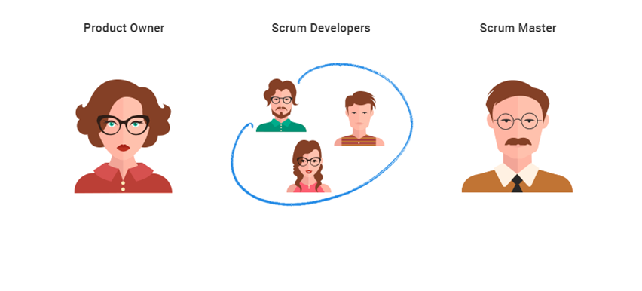
Scrum team major players

Slide 30
Scrum team major players
Product owner: She is responsible for the overall project. She/he decides which features are important and prioritize the tasks that developers need to work on. She/he also may be a point of contact for stakeholders and tries to maximize the value of the project.
Scrum developers: Write codes and test the software. They actually take care of the tasks that the product owner defines.

Slide 31
Scrum team major players
Scrum master: Creates the communication bridge between the Product Owner and the developers team.
He is usually possesses a strong technical knowledge, and actively participates in the development process. He works with the product owner to keep the Backlog ordered, and with the developer team to maximize productivity. He, however, does not micro-manage as the team is self-organized.
He is responsible of organizing the sprint rituals, removing impediments and preventing unplanned works to be worked on.

Slide 32
How is the Scrum process?
Unlike the Waterfall process, We don't work on the project from start to finish, instead divide the project into different pieces according to the product backlog and work on one piece in a short period of time known as sprint.
We would have a Planning Board for each sprint and developers aim to finish all of the user stories for that sprint on the board by estimating how long each story would take to be done before the sprint ends.
After each sprint we can also optionally measure our speed of development in that sprint by drawing a Burndown Chart to see how well we have performed and be able to improve our development velocity and estimations for the next sprint.

Slide 33
How is the Scrum process?
So in general, each sprint has a predetermined number of tasks and they happen in a short period of time. So in this way any barriers will be highlighted very quickly and be fixed, team members also remain focused on small number of tasks and know exactly what they need to do. Any unplanned tasks or requirements can easily be planned into the next sprint.
This whole process helps developers to have a constant speed of development, do better team work, provide early feedbacks to product owner and eventually build a better product.

Slide 34
What is Product Backlog?
It's an ordered list of the tasks that should be worked on to deliver the product. Product owner defines and maintains it.
It's actually a living list which grows, shrinks and changes as the projects is being developed.

Slide 35
What is Sprint?
It's a basic unit of development in Scrum. It should be more than a day long and less than one month. It's commonly 1 or 2 weeks long. And the product should be in a stable state after each sprint. So you may say how a project can get stable every week? That's impossible! Well, in reality, it is possible and can be done, however, some rules are needed that we call them sprint rituals.

Slide 36
What is User Story?
A user story is a short, one sentence definition of a feature or functionality. We call it user story because it is presented from the perspective of a user.

Slide 37
What is Planning Board?
It can be a white board which is placed on a wall(Can be a software too!) which has several columns. The number of columns and their meanings differ from one project to another. In each column we would place colored sticky notes, which each one of them represent a User Story.
As the developer team is developing the software in the sprint, these sticky notes move from one column to another one and some new sticky notes may also appear to represent unplanned activities, bugs, etc...

Slide 38
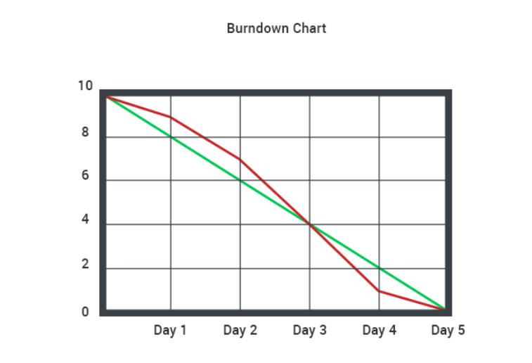
Burndown Chart
It's a chart that shows us our speed of development in a sprint.

Slide 39
planning board
Imagine we have a board that consists of 4 main columns:
Product Backlog: All the project stories reside here.
Sprint Backlog: The stories that should be done in the current sprint are here and the team focus to finish them all by the end of the sprint.
Working On: Team members take a story from the 'Sprint Backlog' column and put them here to show others what are they currently working on. This is needed for transparency and improving productivity.
Done: This column is the place where all completed stories go. Ideally, all of the stories in 'Sprint Backlog' should be here by the end of the sprint.

Slide 40
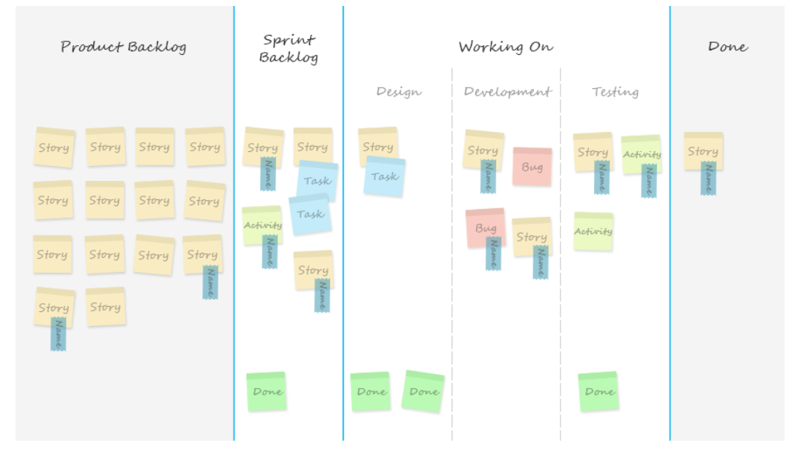
planning board

Slide 41
The Definition of Done:
The definition of Done is very important. We should clearly state that what do we mean by Done, and when a story is considered as Done and can be moved to the 'Done' column on our board.
Actually there is no exact rule for this, but we need to define for our project according to our needs and tasks.
We can for example consider a story as Done when all of the following steps are done with it: Analyze data, draw sketch, create GUI mockup, write unit tests, write code, refactor, make sure tests pass, let another team member test manually, pass functional or acceptance tests, compile and publish.

Slide 42
Introducing sprint rituals
So as we know, after each sprint, our product should be in a stable state. But how is that possible? Well, we need some rules and meetings which are called sprint rituals.

Slide 43
Sprint planning
Occurs at the start of the sprint. Teams review the product backlog, pick up some of the high priority tasks and try to deliver them by the end of the sprint.
How long does it take? This meeting can take a whole day, but shorter sprints only need a couple of hours or so.
What are its results? After the meeting we will have sprint backlog. It includes some tasks that need to be done in the current sprint from the product backlog.

Slide 44
Stand up (Daily Scrum):
Occurs early in the day at an exact hour and each team member needs to answer to the following three questions:
What you achieved yesterday?
What you will achieve today?
Are there any problems blocking you?
Scrum master should help to solve the blocking problems and impediments. Sometimes the problems can be solved in a timely manner but other times, there might be a serious issue that solving it itself would take a couple of weeks. Resolving any blocking issue that is preventing the development process should be the team's high priority.

Slide 45
Stand up (Daily Scrum):
How long does it take? Stand up should be fairly quick, each team member should only speak for a couple of minutes. That's why all team members stand up and speak, so after a little while if you have seen that someone is looking for a chair to sit, it's probable that the meeting has gone too far!
What are its results? Transparency about what each team member is working on and identifying the impediments.

Slide 46
Sprint review:
Occurs at the end of the sprint. Developers, scrum master and product owner discuss what has been achieved during the sprint. And a Demo should be prepared to show to the product owner the new features that has been added.
How long does it take? Well not more than an hour or so. It depends on the number of features and how you like to showcase your demo.
What are its results? Based on the demo, product owner can decide whether to publish a new version of the application or not. Sometimes although the added feature is not completed yet, a release will help to gain users' feedbacks early in order to decide what to modify to satisfy more users as much as possible.

Slide 47
Sprint retrospective:
Occurs at the end of the sprint. In this meeting developers provide feedback about what went well in the passed sprint and what went badly. There are no right or wrong answers here, developers simply give their own opinions. They should put aside their own personal feelings and speak about what is bothering them.
How long does it take? It's a short meeting that wouldn't take more than an hour if there were no serious issues that is bothering team members.
What are its results? The most important thing is to propose a solution for any problem and let everyone a couple of minutes to think about it so that we can avoid it for the next sprint.

